Slide 1
International Workshop for Lancang-Mekong Freshwater Ecosystem Management
Freshwater ecosystem management and Practice in Cambodia
A case study on Boeung Prek Lapouv Protected Landscape
Presented by: Mr. Sophanna Ly
Ministry of Environment, Cambodia
General Directorate of Administration for Nature Conservation and Protection
Department of Freshwater Wetlands Conservation

Slide 2
Freshwater Ecosystem Management and Practice in Cambodia
Outline
Introduction
Implementation Activities
Challenges and Solutions
Conclusion and Way Forwards
Ministry of Environment, Cambodia
Department of Freshwater Wetlands Conservation

Slide 3
Freshwater Ecosystem Management and Practice in Cambodia
Part 1.-
Introduction
Ministry of Environment, Cambodia
Department of Freshwater Wetlands Conservation

Slide 4
Freshwater Ecosystem Management and Practice in Cambodia
Introduction
Boeung Prek Lapouv (BPL) is one of the largest remaining remnants of seasonally-inundated wet grassland in the Lower Mekong and is important for birds, plants and other wildlife, much of it still un-recorded.
BPL is also essential to the lives and livelihoods of many thousands of people because of the wetland resources it provides for them such as fish, edible plants, firewood and land for farming.
For example, in an ecosystem service assessment undertaken by WWT and CCK in 2012, it was found that 68% (almost 3000) of local households collect natural resources from BPL
Ministry of Environment, Cambodia
Department of Freshwater Wetlands Conservation

Slide 5
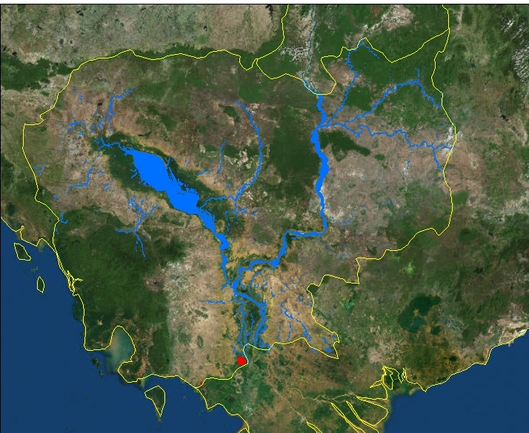
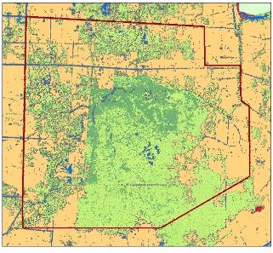
Freshwater Ecosystem Management and Practice in Cambodia
Location and hydrology
8305 ha
Ministry of Environment, Cambodia
Department of Freshwater Wetlands Conservation

Slide 6
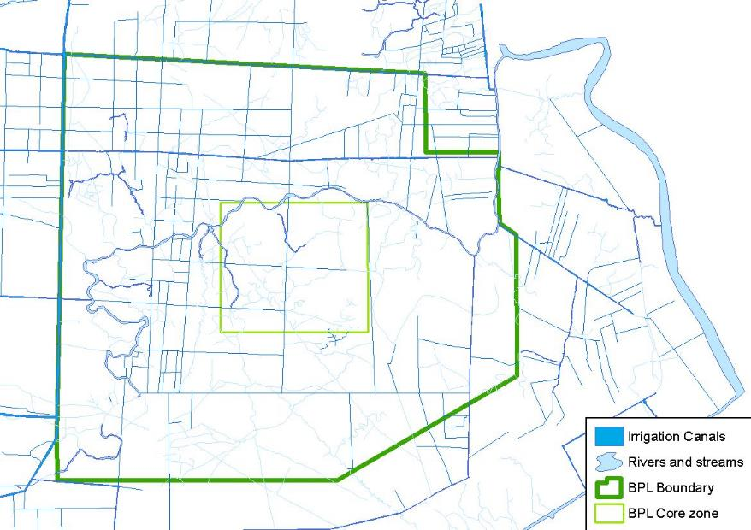
Freshwater Ecosystem Management and Practice in Cambodia
Ministry of Environment, Cambodia
Department of Freshwater Wetlands Conservation

Slide 7
Freshwater Ecosystem Management and Practice in Cambodia
Climate
Climate is dominated by the change of the monsoons, which generates wet and dry seasons of more or less equal length
Generalised climate seasons in the Mekong Basin (source: Mekong River Commission 2005)
Annual rainfall in the delta generally ranges between 1,000 and 1,500 mm, with a long-term average of 1,200 to 1,300 mm.
Ministry of Environment, Cambodia
Department of Freshwater Wetlands Conservation

Slide 8
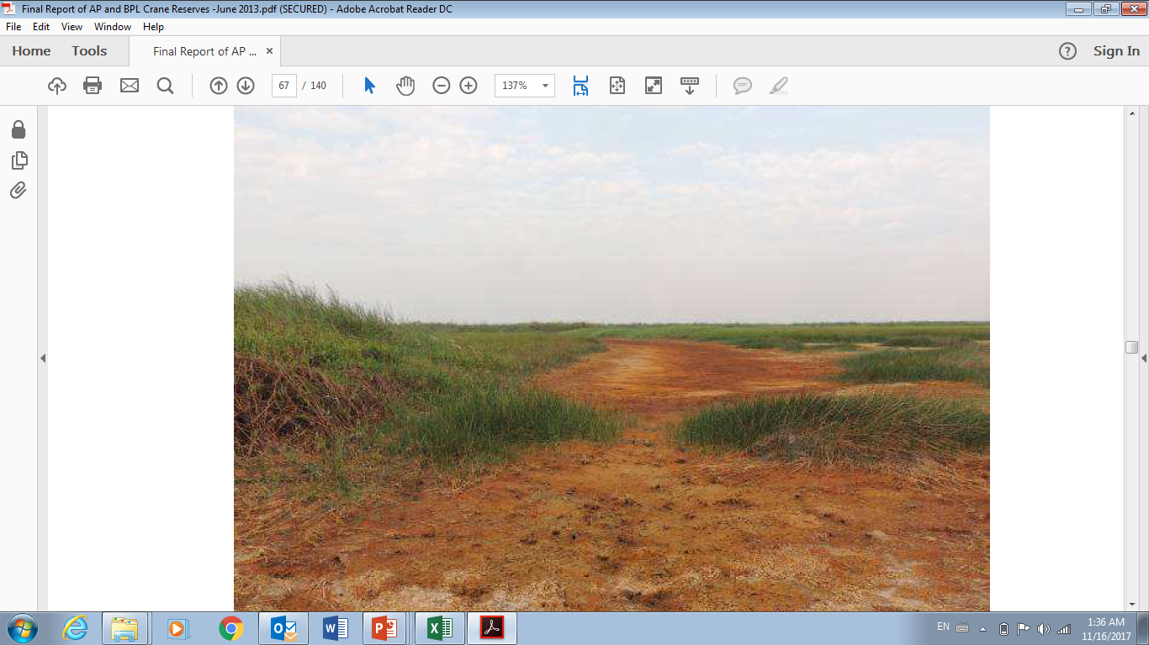
Freshwater Ecosystem Management and Practice in Cambodia
Water quality
Water in BPL mainly originates from the Prek Lapouv stream, Takeo and Bassac rivers.
Water was only slightly acidic to neutral with a pH of 5 – 7. In areas with acid sulphate soils the pH was as low as 3.
Dissolved Oxygen (DO) levels in February were low at 3.1 – 5.1 mg/l in canals and streams. This is in contrast to high DO levels measured in November (peak flood period) at 5.1 – 7.1 mg/l
Ministry of Environment, Cambodia
Department of Freshwater Wetlands Conservation

Slide 9
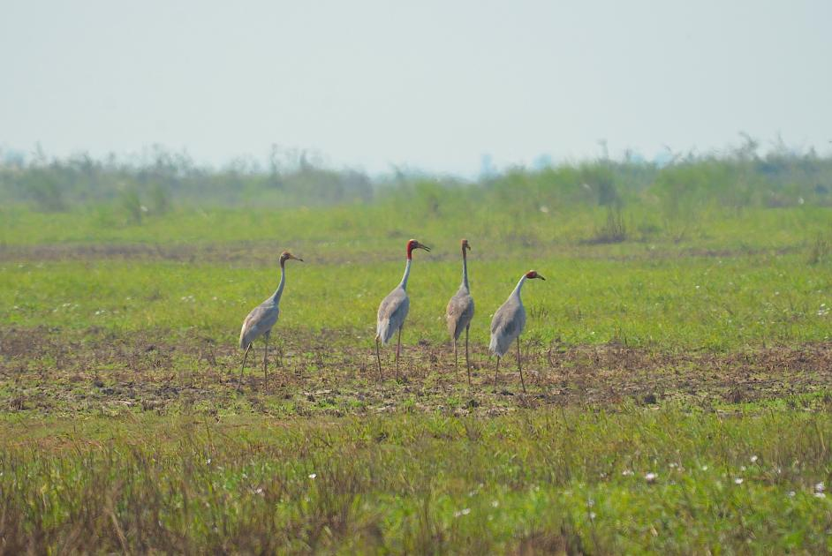
Freshwater Ecosystem Management and Practice in Cambodia
Flora
A rapid assessment of flora in BPL conducted in February 2013 identified 65 species
Seasonally Inundated Grasslands
Echinochloa stagnina - Leersia hexandra
Ischaemum sp - Leersia hexandra;
Eleocharis dulcis;
Saccharum spontaneum - Phragmites vallatoria;
Ministry of Environment, Cambodia
Department of Freshwater Wetlands Conservation

Slide 10
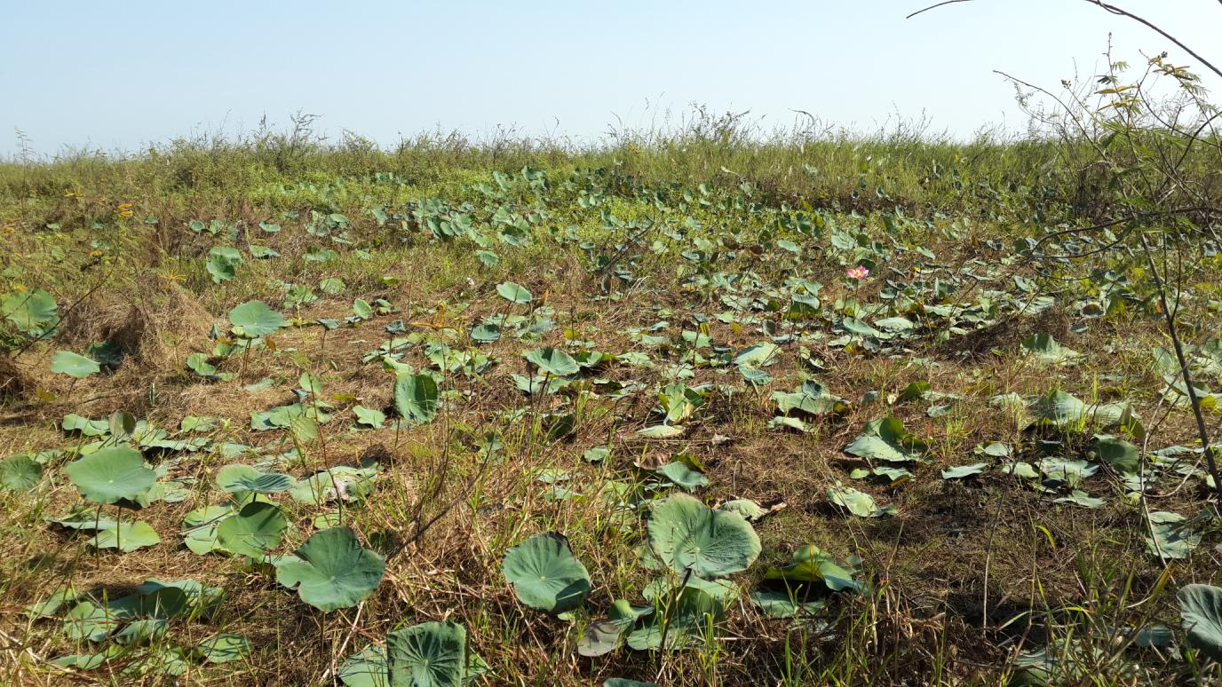
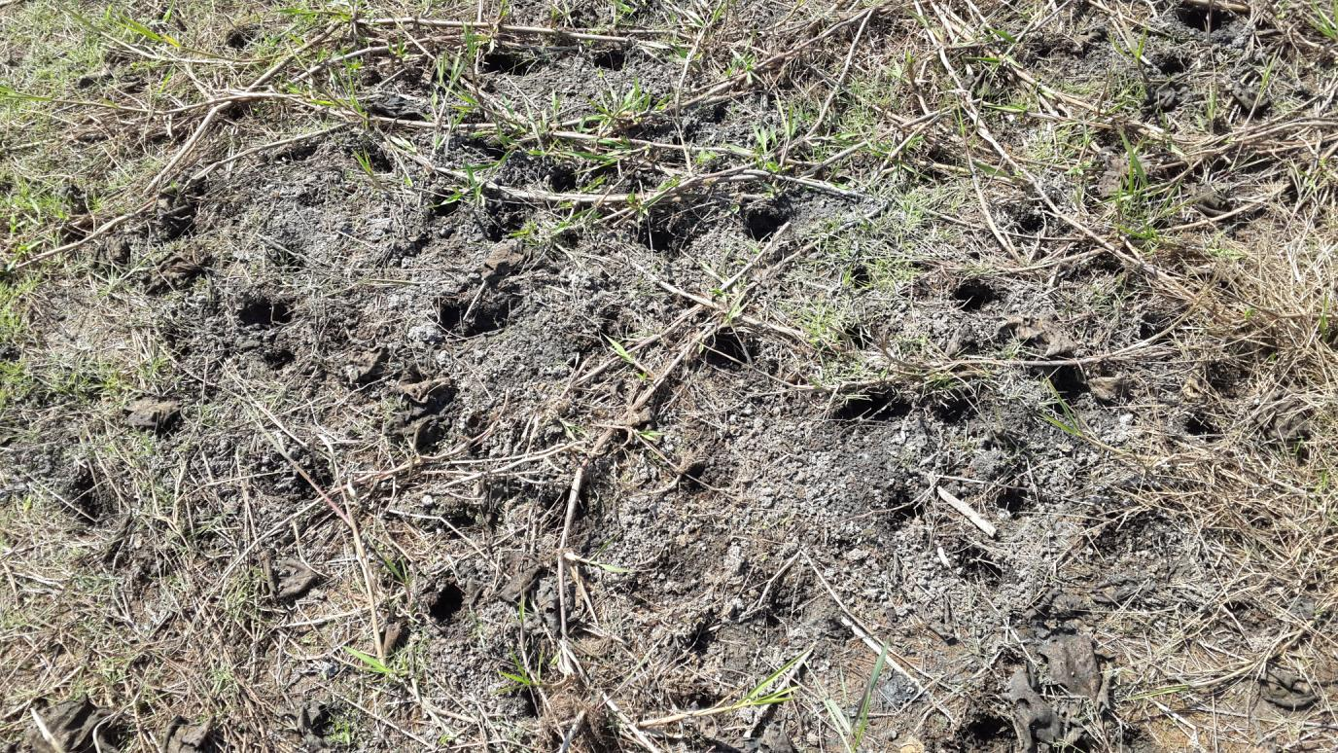
Freshwater Ecosystem Management and Practice in Cambodia
Flora (cont’d)
Aquatic habitats
Cyperus plant community
Nelumbo nucifera (Lotus) – Nymphaea sp. (Water lily)
Scrub
Scrub complex: Plant community comprising mainly of Morinda sp. and Phyllanthus reticulatus.
Mimosa (Mimosa pigra)
Ministry of Environment, Cambodia
Department of Freshwater Wetlands Conservation

Slide 11
Freshwater Ecosystem Management and Practice in Cambodia
Fauna
Bengal Florican (Houbaropsis bengalensis), a Critically Endangered bustard. All threat categories follow those of the IUCN Red List.
Black-faced Spoonbill (Platalea minor), an Endangered winter migrant.
Greater Adjutant (Leptoptilos dubius)
Lesser Adjutant (Leptoptilos javanicus), Vulnerable
Sarus Crane (Grus antigone), Vulnerable
Ministry of Environment, Cambodia
Department of Freshwater Wetlands Conservation

Slide 12
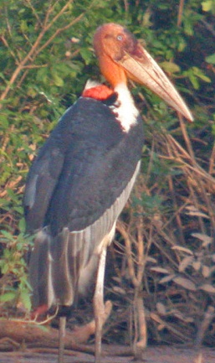
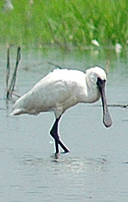
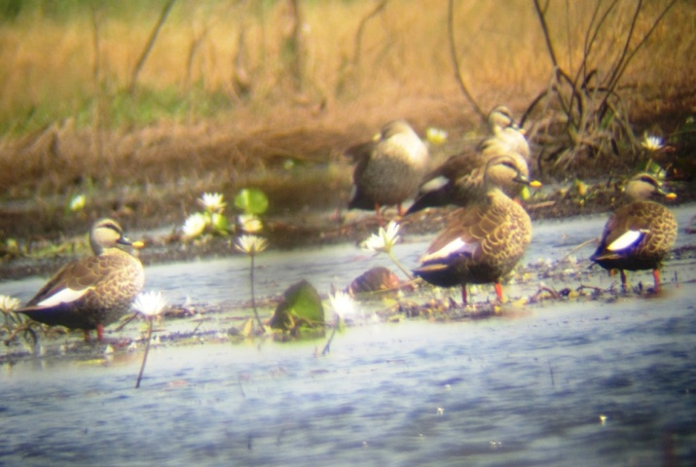
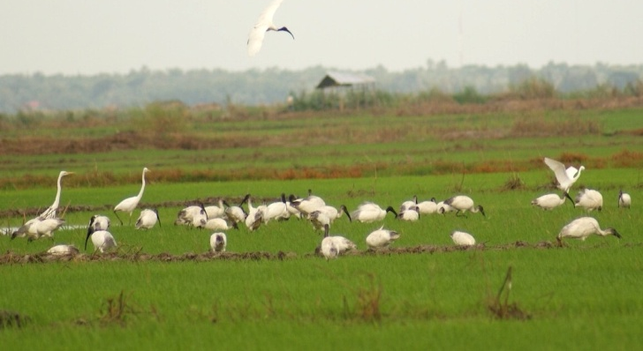
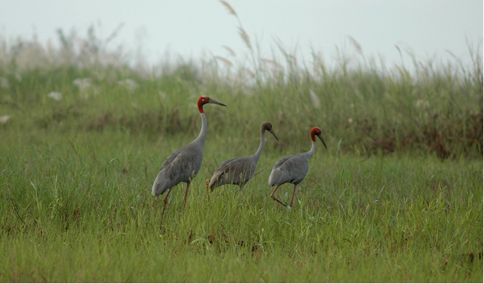
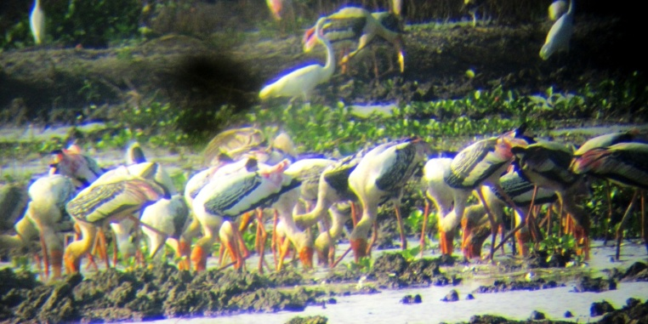
Freshwater Ecosystem Management and Practice in Cambodia
Fauna (cont’d)
Ministry of Environment, Cambodia
Department of Freshwater Wetlands Conservation

Slide 13
Freshwater Ecosystem Management and Practice in Cambodia
Fauna (cont’d)
Ministry of Environment, Cambodia
Department of Freshwater Wetlands Conservation

Slide 14
Freshwater Ecosystem Management and Practice in Cambodia
Fauna (cont’d)
Ministry of Environment, Cambodia
Department of Freshwater Wetlands Conservation

Slide 15
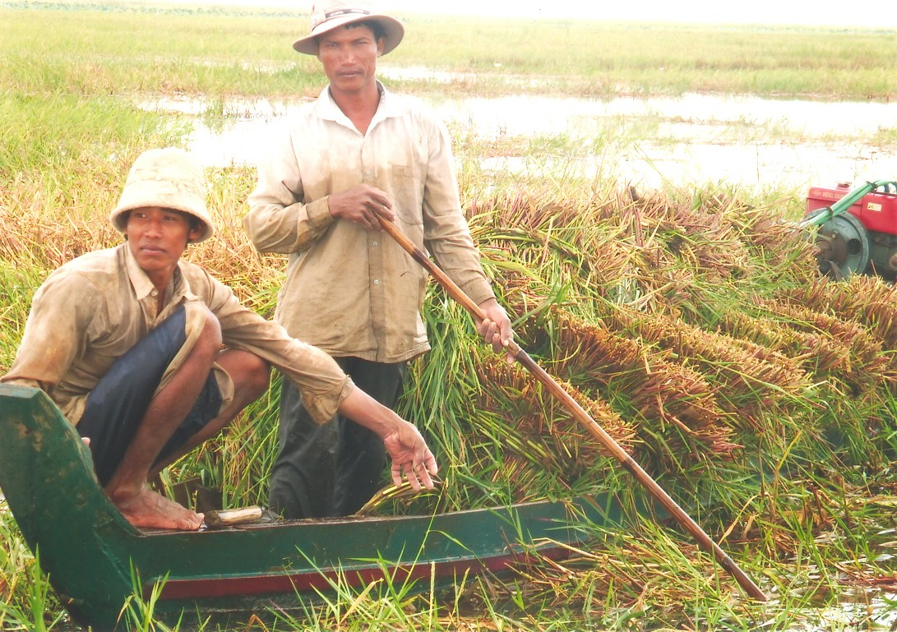
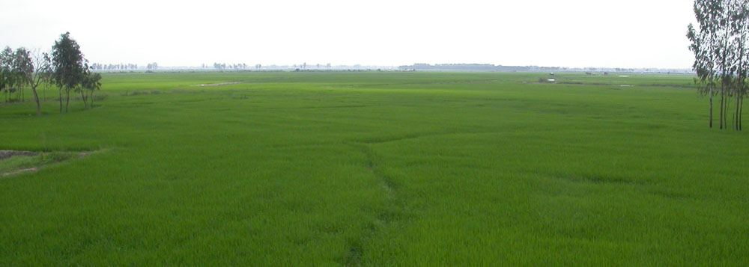
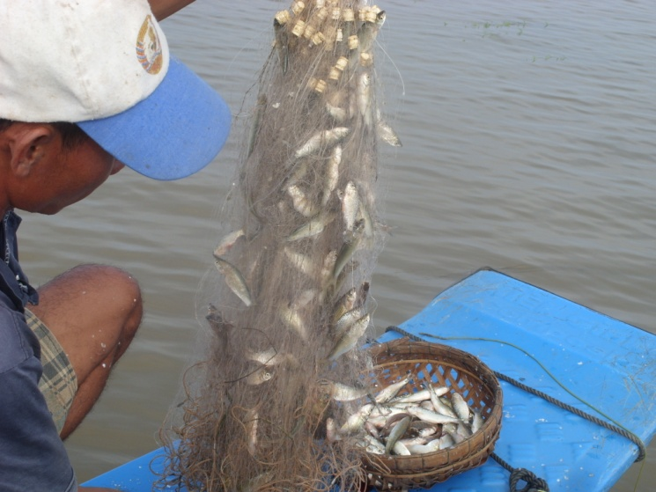
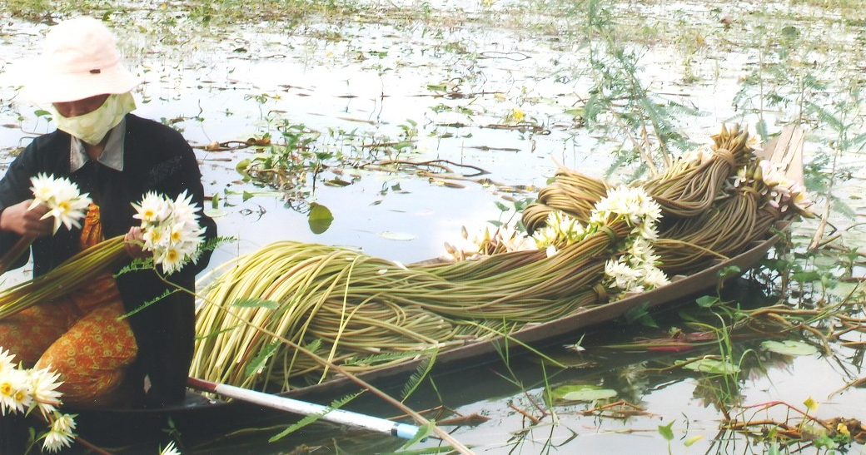
Freshwater Ecosystem Management and Practice in Cambodia
Ecosystem services
Ministry of Environment, Cambodia
Department of Freshwater Wetlands Conservation

Slide 16
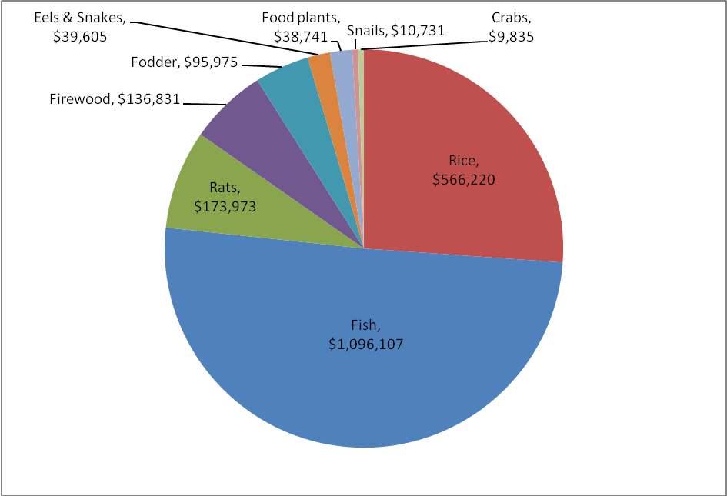
Freshwater Ecosystem Management and Practice in Cambodia
Ecosystem services (cont’d)
Total net annual values of different products harvested from BPL in 2012 was calculated at USD 2,168,019.
Ministry of Environment, Cambodia
Department of Freshwater Wetlands Conservation

Slide 17
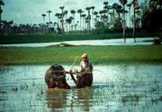
Freshwater Ecosystem Management and Practice in Cambodia
Objectives
ensure the conservation and protection of natural landscape, ecosystems, culture, and biodiversity;
provide products and nature’s services to sustainable use; and
encourage local communities as well as the publics to participate in the management, protection, and conservation of biodiversity and natural resources in the region.
Ministry of Environment, Cambodia
Department of Freshwater Wetlands Conservation

Slide 18
Freshwater Ecosystem Management and Practice in Cambodia
Part 2.-
Implementation Activities
Ministry of Environment, Cambodia
Department of Freshwater Wetlands Conservation

Slide 19
Freshwater Ecosystem Management and Practice in Cambodia
Implement activities
Patrols;
Monitoring and Statistical biodiversity records;
Hydrological management;
Awareness raising.
Ministry of Environment, Cambodia
Department of Freshwater Wetlands Conservation

Slide 20
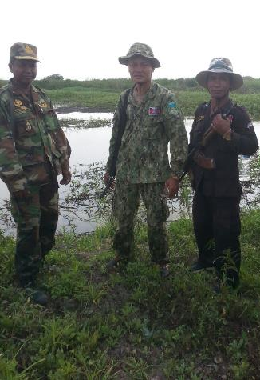
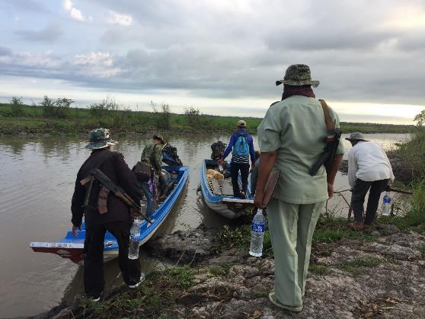
Freshwater Ecosystem Management and Practice in Cambodia
Implement activities (cont’d)
Patrols
Ministry of Environment, Cambodia
Department of Freshwater Wetlands Conservation

Slide 21
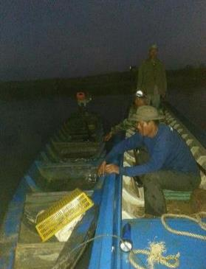
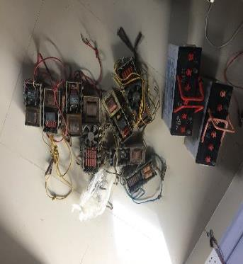
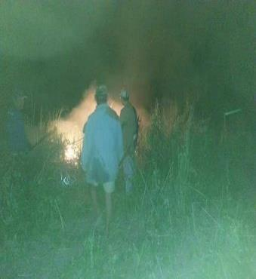
Freshwater Ecosystem Management and Practice in Cambodia
Implement activities (cont’d)
Patrols
Ministry of Environment, Cambodia
Department of Freshwater Wetlands Conservation

Slide 22
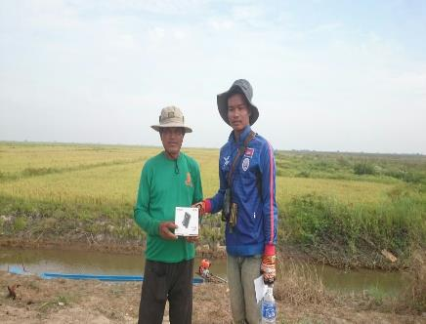
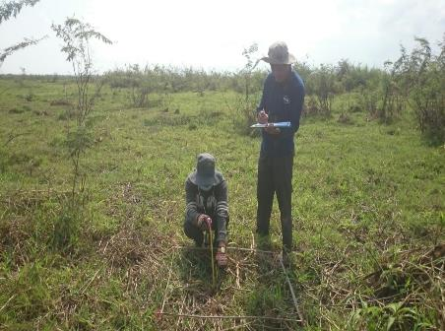
Freshwater Ecosystem Management and Practice in Cambodia
Implement activities (cont’d)
Monitoring and biodiversity statistical records
Ministry of Environment, Cambodia
Department of Freshwater Wetlands Conservation

Slide 23
Freshwater Ecosystem Management and Practice in Cambodia
Implement activities (cont’d)
Bird species population count in January 2017 at BPL
Ministry of Environment, Cambodia
Department of Freshwater Wetlands Conservation

Slide 24
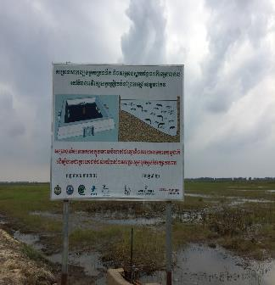
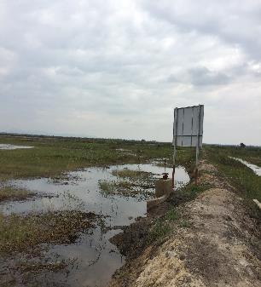
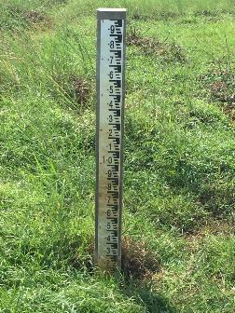
Freshwater Ecosystem Management and Practice in Cambodia
Hydrological management
Ministry of Environment, Cambodia
Department of Freshwater Wetlands Conservation

Slide 25
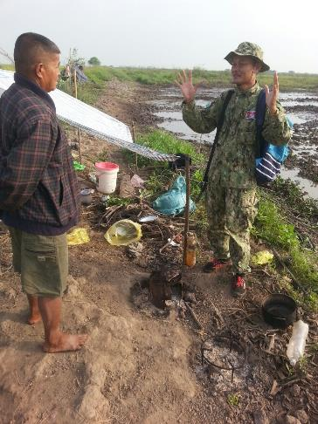
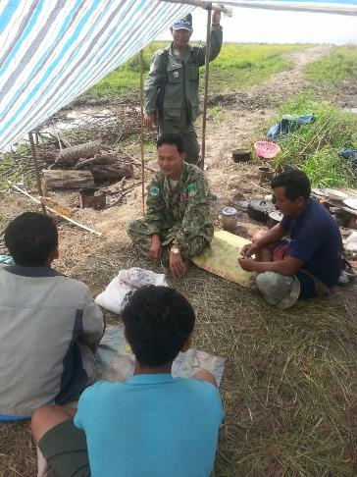
Freshwater Ecosystem Management and Practice in Cambodia
Awareness Raising
Ministry of Environment, Cambodia
Department of Freshwater Wetlands Conservation

Slide 26
Freshwater Ecosystem Management and Practice in Cambodia
Part 3.-
Challenges
Ministry of Environment, Cambodia
Department of Freshwater Wetlands Conservation

Slide 27
Freshwater Ecosystem Management and Practice in Cambodia
Challenges
Decrease in population of Sarus Crane and their early departure from the reserve;
Unbalancing ecosystems;
Rice cultivation potentially affects water quality;
INNS such as mimosa pigra, impomea ruben,
Illegal fishings;
Land encroachment even not in large scale;
Environmental awareness raising to local people;
Rangers’ capacity is limit;
Project funding.
Ministry of Environment, Cambodia
Department of Freshwater Wetlands Conservation

Slide 28
Freshwater Ecosystem Management and Practice in Cambodia
Solutions
Placing tracking tools on the leg of Sarus crane ;
Finding effective mechanism to naturally retain more water in the piloting dike such that Sarus crane can feed in the reserve longer;
Enhancing law enforcement;
Sarus crane rice community groups;
Rapid assessment on plant communities;
Establishment of committee on illegal activities elimination and zonation;
Zonation and boundary demarcation- 4 zones are divided in a protected areas;
Ministry of Environment, Cambodia
Department of Freshwater Wetlands Conservation

Slide 29
Freshwater Ecosystem Management and Practice in Cambodia
Solutions (cont’d)
Vulnerability assessment;
Drafting guidance for the wise-use of freshwater wetlands in Cambodia;
INNS management and control;
Establishing more environmental awareness platforms;
Capacity building to rangers;
Finding more funds to support the projects.
Ministry of Environment, Cambodia
Department of Freshwater Wetlands Conservation

Slide 30
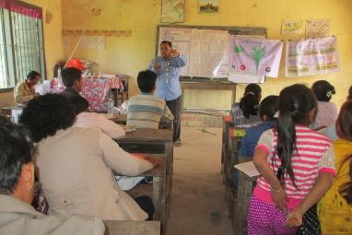
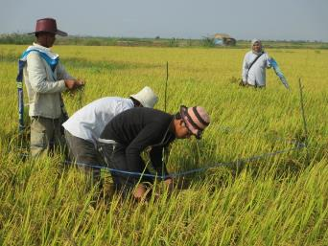
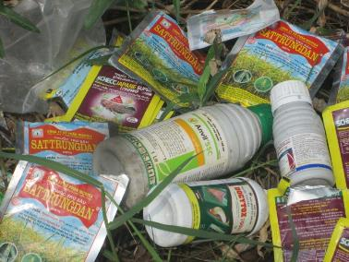
Freshwater Ecosystem Management and Practice in Cambodia
Sustainable Rice Farming
Ministry of Environment, Cambodia
Department of Freshwater Wetlands Conservation

Slide 31
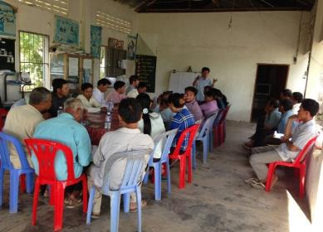
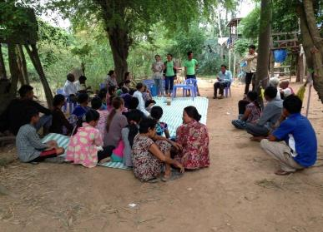
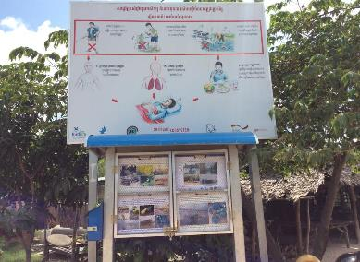
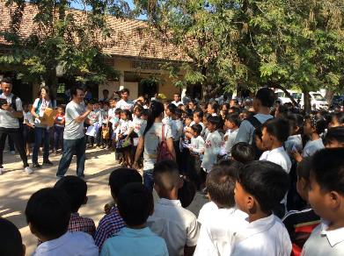
Freshwater Ecosystem Management and Practice in Cambodia
Awareness Raising
Ministry of Environment, Cambodia
Department of Freshwater Wetlands Conservation

Slide 32
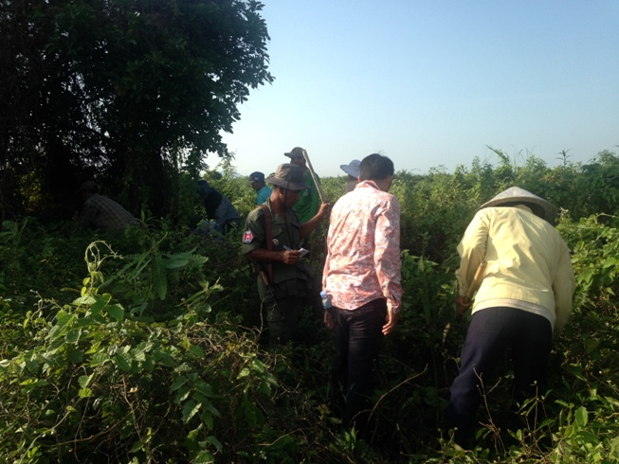
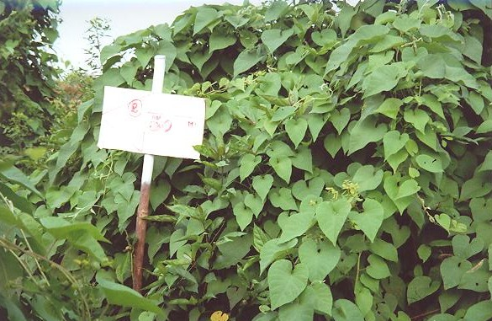
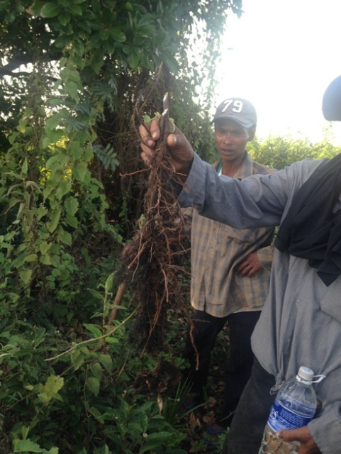
Freshwater Ecosystem Management and Practice in Cambodia
Awareness Raising
Ministry of Environment, Cambodia
Department of Freshwater Wetlands Conservation

Slide 33
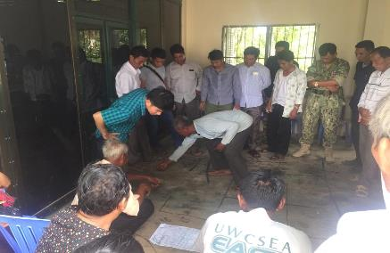
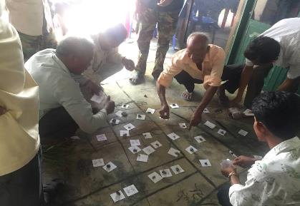
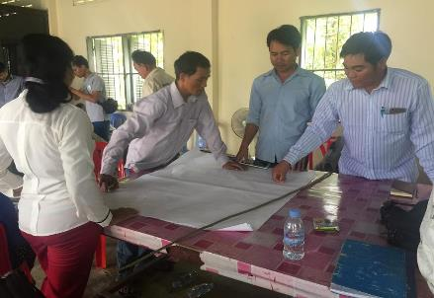
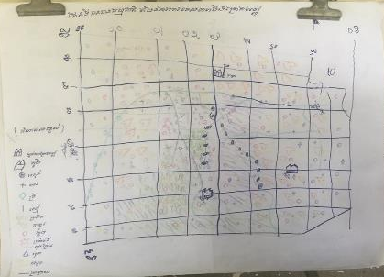
Freshwater Ecosystem Management and Practice in Cambodia
Vulnerability Assessment
Ministry of Environment, Cambodia
Department of Freshwater Wetlands Conservation

Slide 34
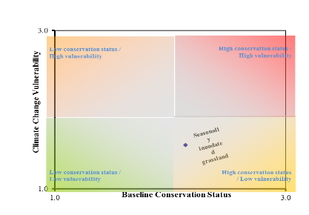
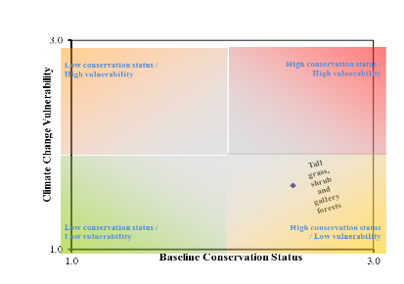
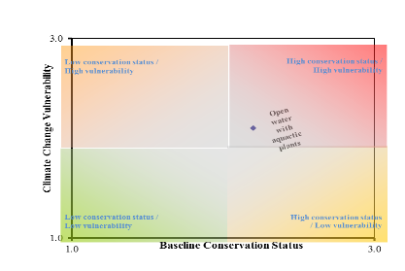
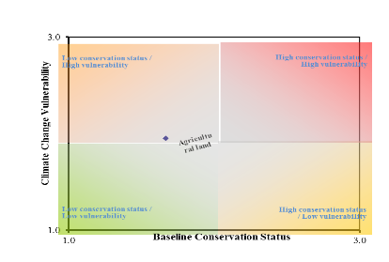
Freshwater Ecosystem Management and Practice in Cambodia
Vulnerability Assessment Result
Ministry of Environment, Cambodia
Department of Freshwater Wetlands Conservation

Slide 35
Freshwater Ecosystem Management and Practice in Cambodia
Part A: Background Information
Introduction
Part B: Wetland Management Planning and Engaging with People
Wetland Management Planning
Engaging with Stakeholders
Part C: Managing Wetlands: Information Key Wetland Features and Activities
Agriculture
Fisheries
Seasonally inundated flooded forest
Wetland fauna
Invasive species
Ecotourism
Pollution from Industry
Ministry of Environment, Cambodia
Department of Freshwater Wetlands Conservation

Slide 36
Freshwater Ecosystem Management and Practice in Cambodia
Part 4.-
Conclusion and Next steps
Ministry of Environment, Cambodia
Department of Freshwater Wetlands Conservation

Slide 37
Freshwater Ecosystem Management and Practice in Cambodia
Conclusions and Next steps
BPL is a very important wetland for local people;
Decrease in Sarus crane population and other key bird species;
Solving mechanism is under processed even the result is not yet concluded with respect to such decrease;
Difficult in controlling mimosa pigra;
Based upon the VA tools, the vulnerability of habitats at BPL to climate change are not serious;
Capacity building to ranger is needed;
Finding more funds to support the projects;
Zonation of BPL;
Endorse BPL to be nominated as Ramsar site.
Ministry of Environment, Cambodia
Department of Freshwater Wetlands Conservation

Slide 38
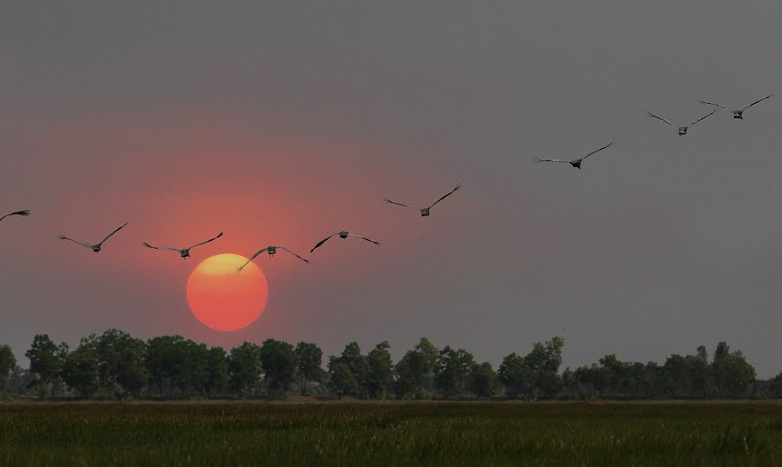
Freshwater Ecosystem Management and Practice in Cambodia
Thank for your listening!
Ministry of Environment, Cambodia
Department of Freshwater Wetlands Conservation

