Slide 1
MINISTRY OF NATURAL RESOURCES AND ENVIRONMENT
DEPARTMENT OF WATER RESOURCES MANAGEMENT
FRESH WATER RESOURCES MANAGEMENT IN VIETNAM
Mrs. Truong Mai Hoa
Department of Water Resources Management

Slide 2
Content:
General Information of water resources in Vietnam
Water resources legislation
Water resources monitoring

Slide 3
GENERAL INFORMATION OF WATER RESOURCES IN VIETNAM

Slide 4
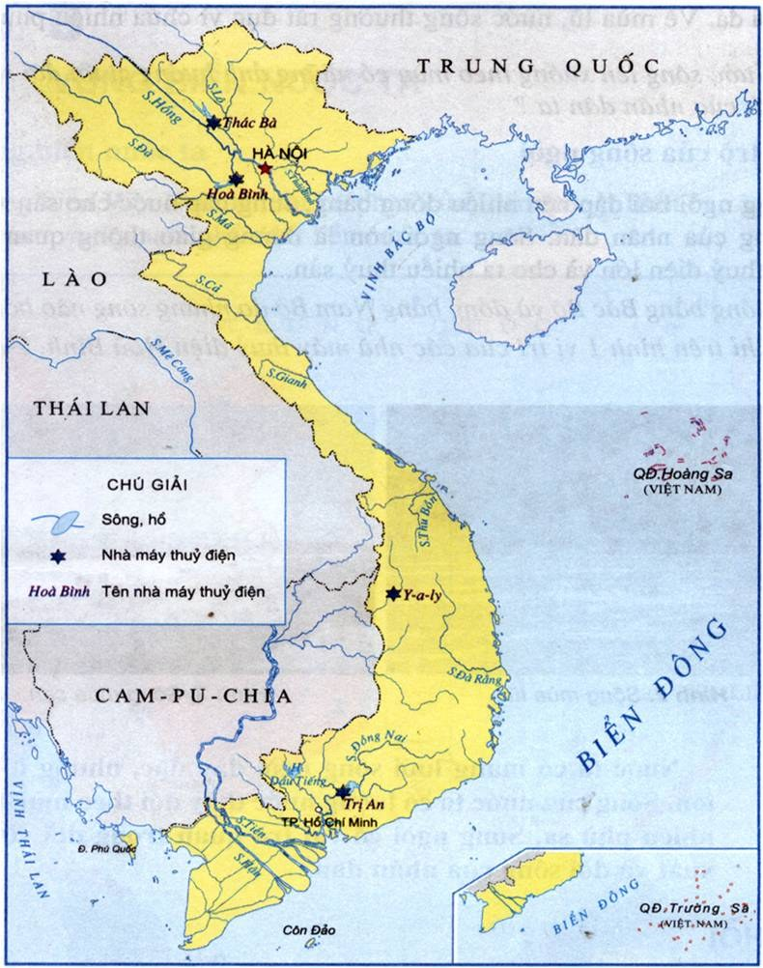
- Vietnam is located in the downstream of large water sources, especially cross border Hong river and Mekong River etc.
- Viet Nam pays special attention on the management, exploitation and use of water resources, prevention, combat against and overcoming of the harms caused by water

Slide 5
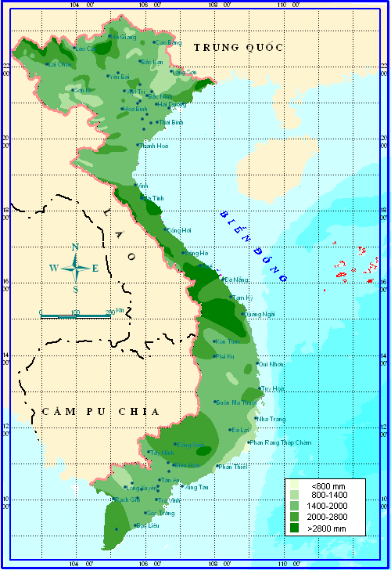
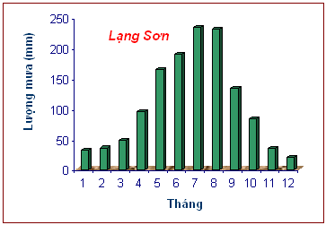
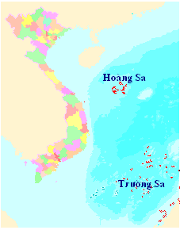
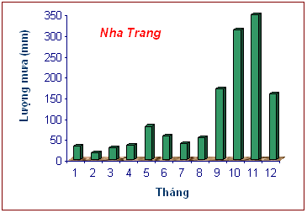
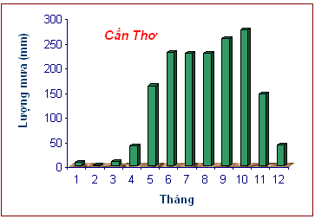
1. Rainfall
Mean annual rainfall: 1960 mm, equivalent to 640 x 10⁹ cubic meters
Annual rainfall varies from region to region in the country: 600 mm to more than 5000 mm
Most of annual rainfall occurs during 4-5 months in rainy season, account for 75-85% of the annual rainfall volume
Lượng mưa trung bình năm trên lãnh thổ Việt Nam
Chú giải

Slide 6
2. Surface water
River network:
- More than 2,300 perennial rivers over 10 km in length
- 14 river basins with an area of more than 2,500 km2, 10 of which have an area of more than 10,000 km² .

Slide 7
2. Surface water (Cont.)
Total annual volume of surface water: 830-850 x 10⁹ m³
- About 60% in the Cuu Long (Delta) river basin
- More than 16% in the Red- Thai Binh basin
- More than 4% in the Dong Nai basin, where most socio-economic development activity occurs.
- 20% in central part of Viet Nam

Slide 8
2. Surface water (cont.)
More than 60% of Vietnam’s surface water is generated outside the country.
The average per capita of surface water availability generated within the country is about 3840 m³/year/cap.
The dry season period is from 6 to 9 months. Average discharge during the dry season is about 20-30% of total annual discharge.

Slide 9
3. Groundwater
Total ‘groundwater potential’ : 63,000 million m³ per year.
The distribution of groundwater potential per capita ranges from 3,770m/cap/year in the North-west to as low as 84 m/cap/year in the Mekong Delta

Slide 10
4. Major water issues
Shortage of water in the dry season is occurring with higher frequency and more severe impacts,
Wasteful and inefficient use of water
Degradation and exhaustion of groundwater
Lack of an approach in water exploitation and use
Population growth and poverty integrated and multi-purpose
Water sources continue to be polluted and degraded
Incomplete legal system for water resources management and the inadequate organisation and management capacity in water resources
Lack of mechanisms and policies, especially economic and financial policies in water resources
Inadequate and inaccurate information and data on water resources and constraints on information sharing

Slide 11
LESISLATION

Slide 12
1. Institutional Arrangements
National WR Council
MONRE
Vietnam National Mekong Committee VNMC
Ministry of Agriculture and Rural Development – MARD
Ministry of Industry and Trade - MIT
Ministry of Health- MOH
Ministry of Construction – MOC
Ministry of Science and Technology- MST
Ministry of Finance – MF
Ministry of Planning and Investment- MPI
Provincial Committees

Slide 13
2. The legal Framework for WRM
Basic Regulation:
Law
Law on Water Resources No. 17/2012/QH13 replacing the Law on water Resources 1998
Other key Regulations.
Decree
Decree No.201/2013/ND-CP Detailing the implementation of some articles of the Law on Water Resources.
Decree No 142 on sanction of administrative violation in water and mineral fields.
Decree 21 specifying function, tasks, power and organizational structure of MONRE.
Decree No.102/2008/ND-CP on collection, management, exploitation and use of natural resources and environment data and information.
Others
National Water Resources Strategy towards the year 2020
- Circular No. 27/2014/TT-BTNMT on Groundwater Exploitation Registration, Exploitation, Extraction and Use of Water Resources and Discharge of Wastewater into Water Sources
- Exploitation, Exploration & Drilling of Groundwater
Decision No.17/2006/QDBTNMT; Decision No.13/2007/QD-BTNMT; Decision No.15/2008/QD-BTNMT

Slide 14
2. The legal Framework for WRM (Cont).
Regulations on Sanctions of administrative violations in the field of water resources:
- Law on Handling Administrative Violation No: 15/2012/QH13
- Decree No. 142/2013/NĐ-CP stipulating sanction of administrative violation in the field of water and minerals
- An organization or individual who commits an administrative violation of water resources management regulations shall be subject to one of the following
sanctions:
a. Warning
b. Fine: The maximum fine for an administrative violation of water resources management regulations is 250,000,000 VND for individuals and 500,000,000 VND for organization
Regulation on water resources data & information
- Decree 102/2008/ND-CP
Regulation on water resources fiancing: legislation on tax, fee and charges

Slide 15
3. Law on Water Resources (LWR):
The LWR consists of ten chapters with 79 Articles was approved by National Assembly 13 at its 3rd Section on June 21, 2012, and has been in force since January 01, 2013
Ch.1 General Provisions
Ch.2. The LWR provides provisions on basic survey, strategy and planning of water resources .
Ch.3. Protection of water resources
Ch.4 Exploitation and use of water resources
Ch.5 The prevention, combat against the harms caused by water
Ch.6 Finance for water resources
Ch.7 International relations on water resources
Ch.8 Responsibility of water resources management
Ch.9 The Specialized inspection and settling disputes on water resources
Ch.10 Finally, implementation provisions

Slide 16
WATER RESOURCES MONITORING SYSTEM IN VIETNAM

Slide 17
water resources monitoring network
Ground water monitoring network (707 wells)
Surface water monitoring network (354 hydrology stations)

Slide 18
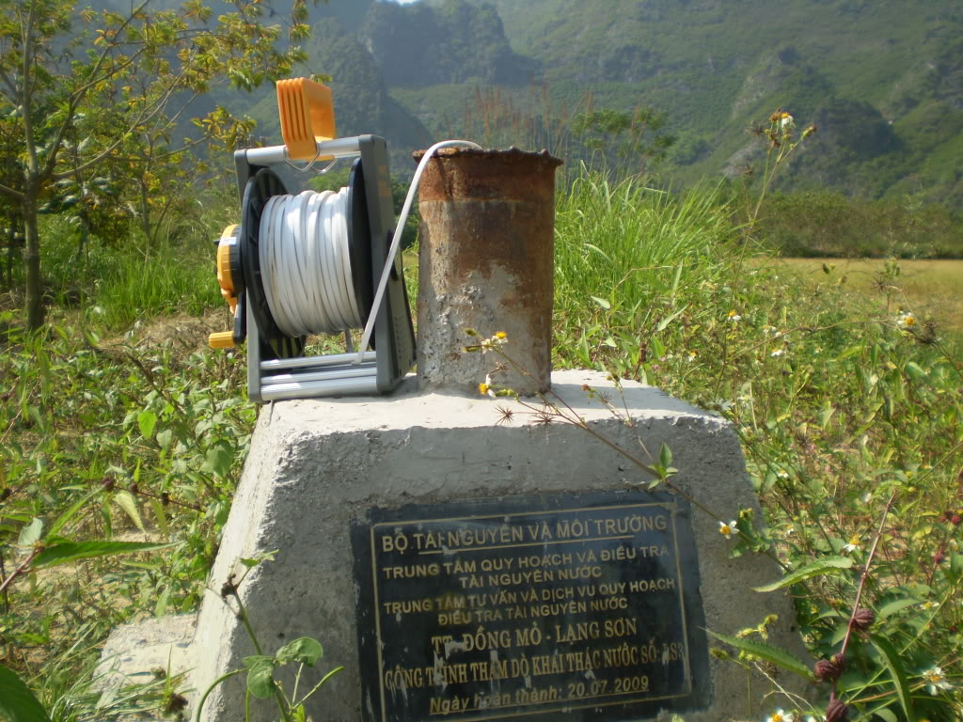
1. The ground water monitoring system in Vietnam
Total: 707 groundwater monitoring constructions:
In the Northern delta: 206 constructions;
In the North Central Coast: 46 constructions;
In the Central Highlands: 205 constructions;
In the South Central Coast: 46 constructions;
In the Mekong Delta: 208 constructions.

Slide 19
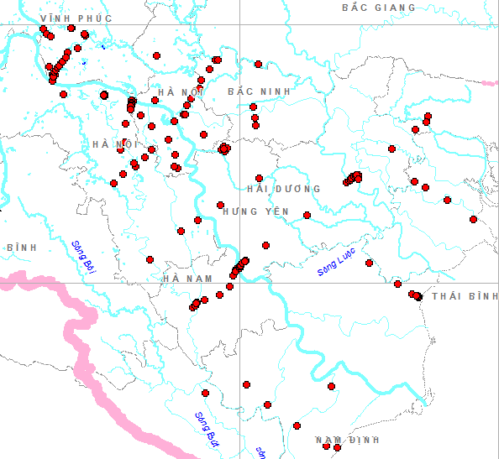
The groundwater monitoring system in the Northern plain.
Within 206 constructions:
- 91 wells monitoring the Holocen aquifer (qh);
- 82 wells monitoring the Pleistocen aquifer (qp);
- 09 wells monitoring the Neogen aquifer (n);
- 03 wells monitoring the Triats aquifer(t);
- 02 wells monitoring the Cacbon - Pecmi aquifer (c-p);
- 01 wells monitoring the Ocdovic - Silur aquifer (o-s).
- There are 10 surface water monitoring constructions to identify the ground-surface water relation;

Slide 20
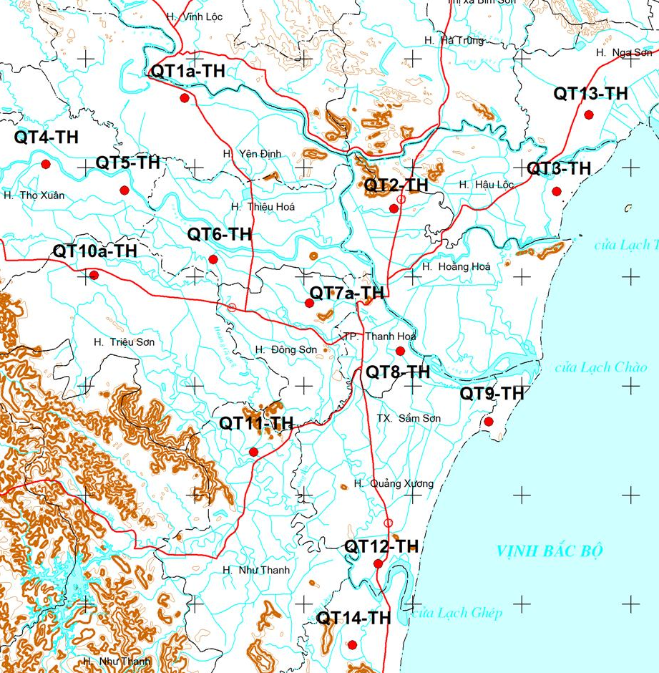
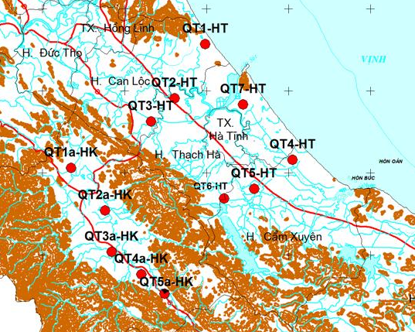
The groundwater monitoring system in the North Central Coast:
Within 46 constructions:
- 17 constructions are monitoring the (qh) aquifer (11 wells in Thanh Hoa and 6 in Ha Tinh);
- 22 constructions are monitoring the (qp) (14 cons. In Thanh Hoa , 8 in Ha Tinh);
- 07 constructions are monitoring the (t) aquifer (located in Ha Tinh province);
Locations of GWM cons. in Ha Tinh
Locations of GWM cons. In Thanh Hoa

Slide 21
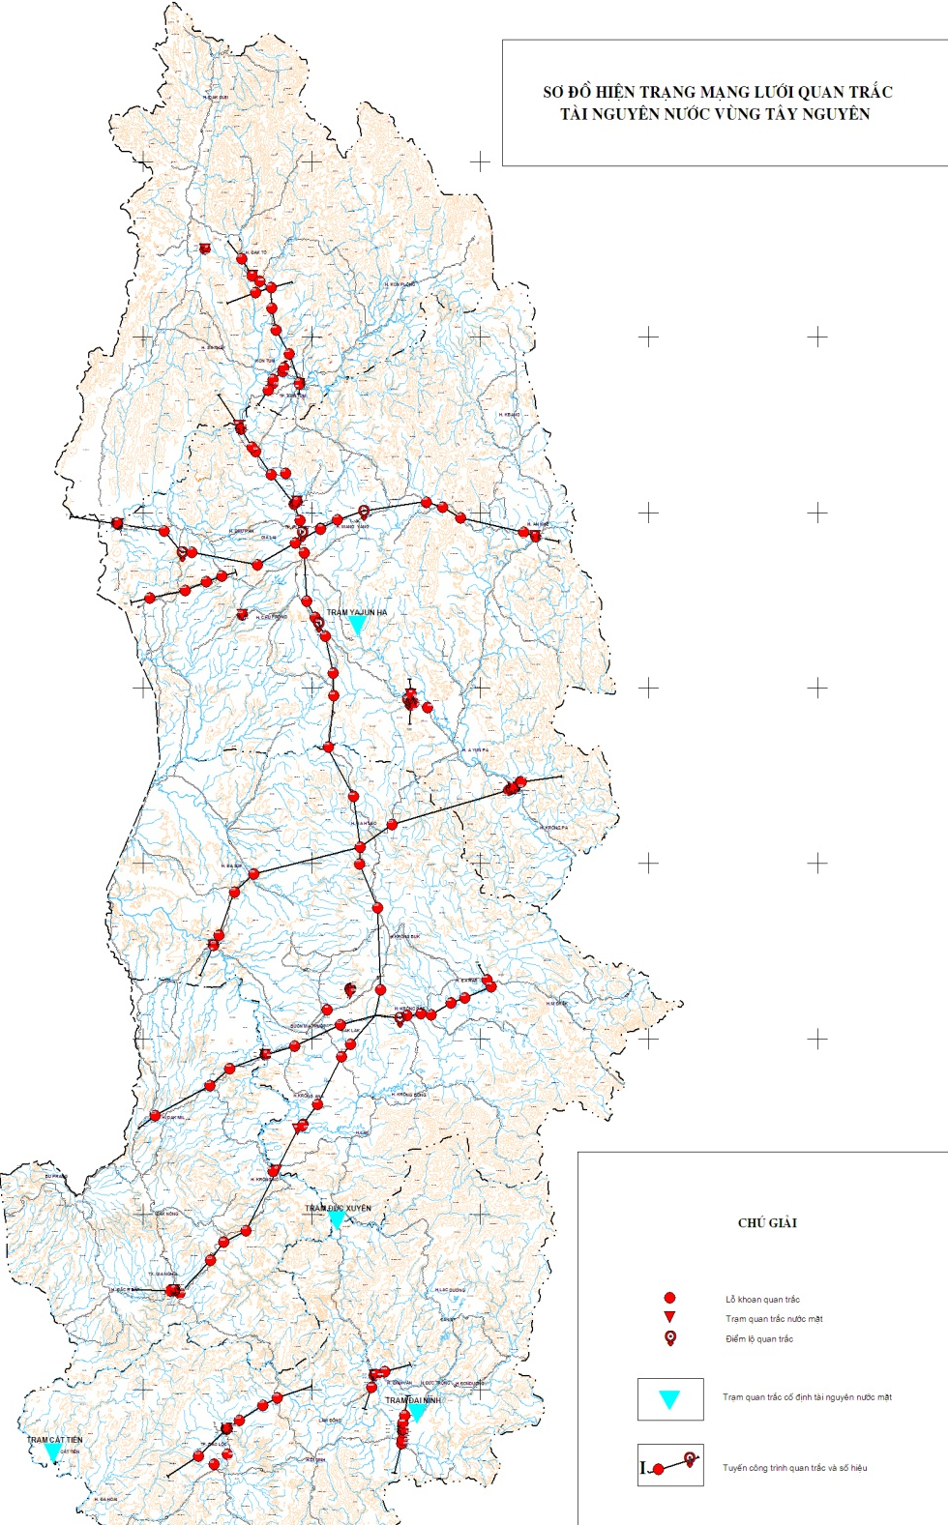
The groundwater monitoring system in the Central Highlands:
Within 205 constructions;
- 16 constructions are monitoring the undivided Quaternary aquifer;
- 107 wells monitoring the bazan aquifer (βQ12, βN2-Q1);
- 20 wells monitoring the Neogen aquifer;
- 14 wells monitoring the Jura aquifer;
- 06 wells monitoring Arkei aquifer;
- Installing 19 surface water monitoring constructions to identify the ground-surface water relation;;

Slide 22
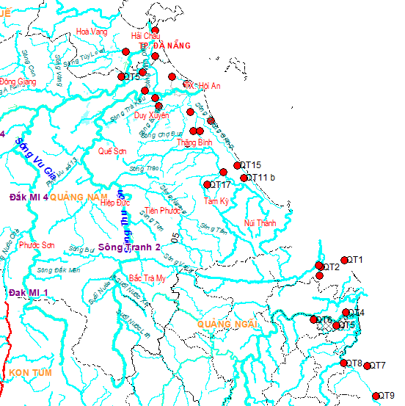
The groundwater monitoring system in the South Central Coast:
Within 46 constructions;
- 25 wells monitoring the qh aquifer;
- 16 wells monitoring the qp aquifer
- 05 wells monitoring the Neogen aquifer;

Slide 23
The groundwater monitoring system in the South
Within 208 constructions;
- 23 wells monitoring the qh aquifer;
- 96 wells monitoring the qp aquifer;
- 10 wells monitoring the bazan aquifer(βQ12, βN2-Q1);
- 78 wells monitoring the Neogen aquifer;
- 02 wells monitoring the Mesozoi aquifer;
- 11 surface water monitoring constructions to identify the ground-surface water relation

Slide 24
Parameters and frequency of monitoring:
a) Parameters
- Water level;
- Water temperature;
- Chemical contents of water;
Well depth;
b) Frequency of monitoring:
- Water level and water temperature: 5 times/ month in the dry season and 10 times/month in the wet season;
- Chemical contents of water: once in the middle of dry season and once in the middle of wet season;
Well depth: 04 times/year.

Slide 25

2. The surface-water monitoring system:
There are 354 hydrology stations in total
122 level 1 stations; 36 level 2 stations; 196 level 3 stations;
Level | Parameters
Level 1 station | Water level, discharge, sediment discharge, water temperature, salinity (in the tidal zone)
Level 2 station | Gauging water level in the whole year and measuring other parameters few times per year (flow, sediment discharge..)
Level 3 station | Gauging water level only

Slide 26
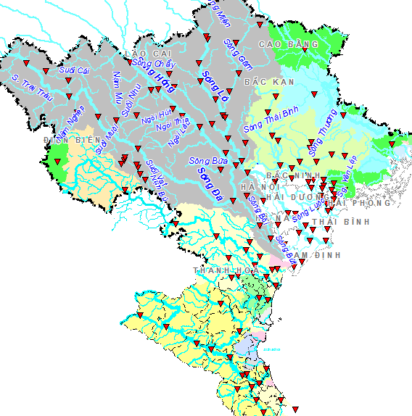
The monitoring stations according to river basins
- The Red – Thai Binh river: 94 stations
- Bang Giang – Ky Cung: 03 stations;
- Ma River: 15 stations;
- Ca River: 17 stations;

Slide 27
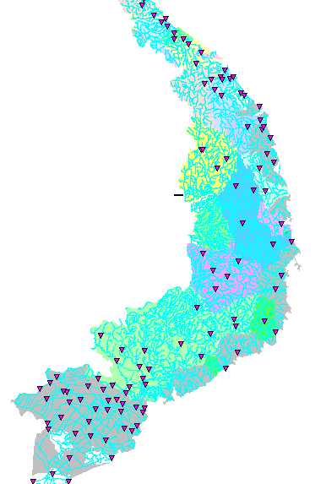
- Vu Gia – Thu Bon: 19 stations;
- Ba River: 05 stations :
- Sesan River:04 stations;
- Srepok River: 05 stations;
- Dong Nai River: 18 stations;
- Mekong River: 35 stations;
- And other stations located at the coastal rivers

Slide 28
Parameters and frequency of monitoring:
a) Parameters
- Water level;
- Flow discharge;
- Water temperature;
Chemical contents of water
b) Frequency of monitoring:
Follow the Vietnam standards issued by the MONRE (Circular 29/2011/TT-BTNMT).

Slide 29
Thank you for your attention

